Slide 1
BeerCityMaps.com
“Connecting Beer Drinkers to Beer Since… today!”

Slide 2
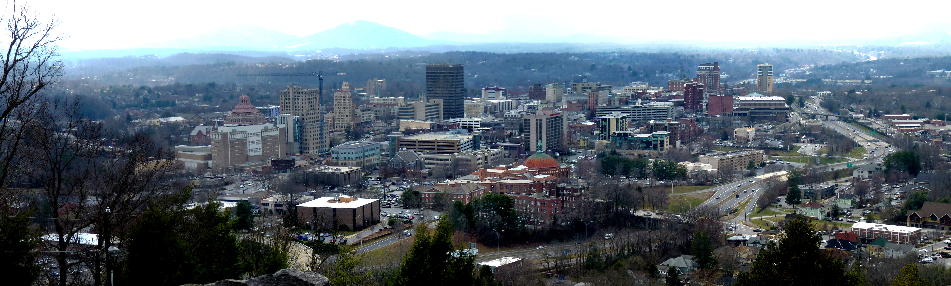
BeerCityMaps.com
Asheville, North Carolina population 90,000 +/- a few thousand
Notes:
A little background about Ashveille, incase you didn’t know…
Asheville has a population of about 90,000
For comparison, my hometown of Seattle Washington has 730,000
The metropolitan area of Ashveille is roughly half a million, Seattle is closer to 4 and a half million.
While it has a city feel to it, its only the 11th largest city in North Carolina. Which is only the 9th most populated state in the US.
What I’m getting at… is that Asheville is SMALL!

Slide 3

BeerCityMaps.com
Tourism
10.9 million visitors per year. 29,800 per DAY!
(that’s more than half as much as the population!)
$107 per day spent by average visitor
Notes:
Tourism is huge in Asheville, one could argue that its practically the only industry here. Some fight it, I embrace it.
Almost 11 million visitors a year, 30 thousand a DAY! That is more than ½ of the population over again visiting.
The average amount spent per person it $107 a day.

Slide 4
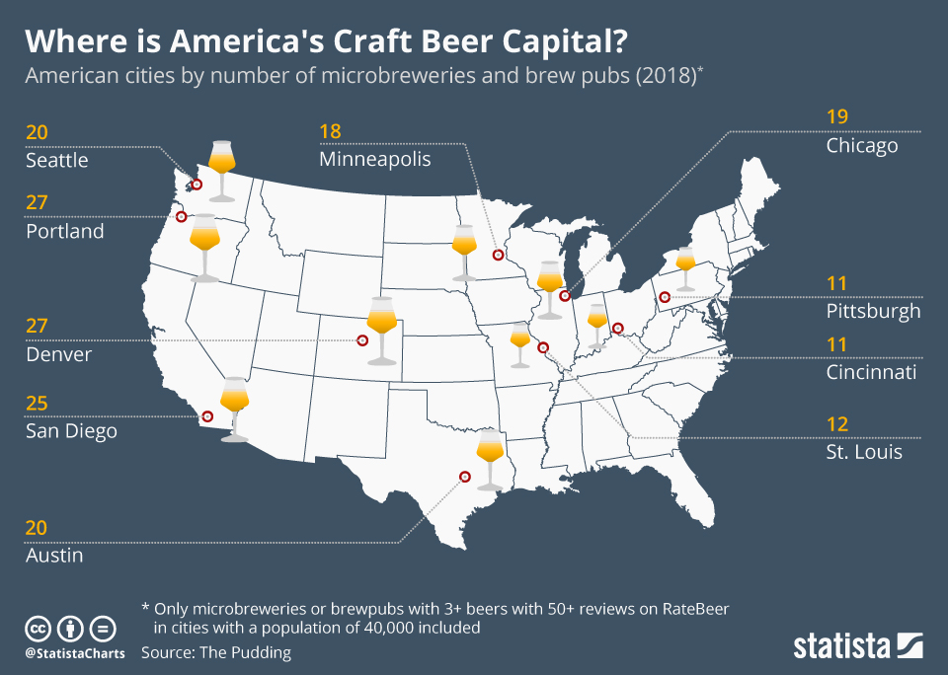
Notes:
So check this out!
Look at the cities with the most craft breweries!
There is my hometown, Seattle with 20!!! Man that’s a lot!
Denver with 27! St. Louis… Cincinnati, etc. PORTLAND has 27! Holy crap!
But wait!
What is missing on this map?

Slide 5
BeerCityMaps
Asheville Brewing Company
Archetype Brewing
Blue Ghost Brewing Company
Blue Mountain Pizza and Brew Pub
Burial Beer
Bhramari Brewhouse
Catawba Brewing
Eluvium Brewing Company
French Broad Brewing
Green Man Brewing
Highland Brewing Co
Hillman Beer
Hi-Wire
Lexington Avenue Brewing
New Belgium
One World Brewing
OysterHouse Brewing Company
Sierra Nevada Brewery
Sweeten Creek Brewing
Thirst Monk
Turgua Brewing Company
Twin Leaf Brewing
UpCountry
Wedge
White Labs
Wicked Weed
Zillichoah Beer Company
Pisgah
Oskar Blues
… not to mention the cideries and distilleries!
Notes:
Asheville Brewing Company
Archetype Brewing
Blue Ghost Brewing Company
Blue Mountain Pizza and Brew Pub
Burial Beer
Bhramari Brewhouse
Catawba Brewing
Eluvium Brewing Company
French Broad Brewing
Green Man Brewing
Highland Brewing Co
Hillman Beer
Hi-Wire
Lexington Avenue Brewing
New Belgium
One World Brewing
OysterHouse Brewing Company
Sierra Nevada Brewery
Sweeten Creek Brewing
Thirst Monk
Turgua Brewing Company
Twin Leaf Brewing
UpCountry
Wedge
White Labs
Wicked Weed
Zillichoah Beer Company
Pisgah
Oskar Blues

Slide 6
BeerCityMaps.com
Beer
Arguably more breweries per capita than any other “city” in the US.
Definitely more breweries per capita than any other city in North Carolina
BeerCity!
Notes:
Ashveille may not be the biggest city… and we may not even have the most breweries (wait… actually, I take that back. We might actually have the most breweries!)
But it would be crazy to say that we don’t have a huge beer scene!

Slide 7
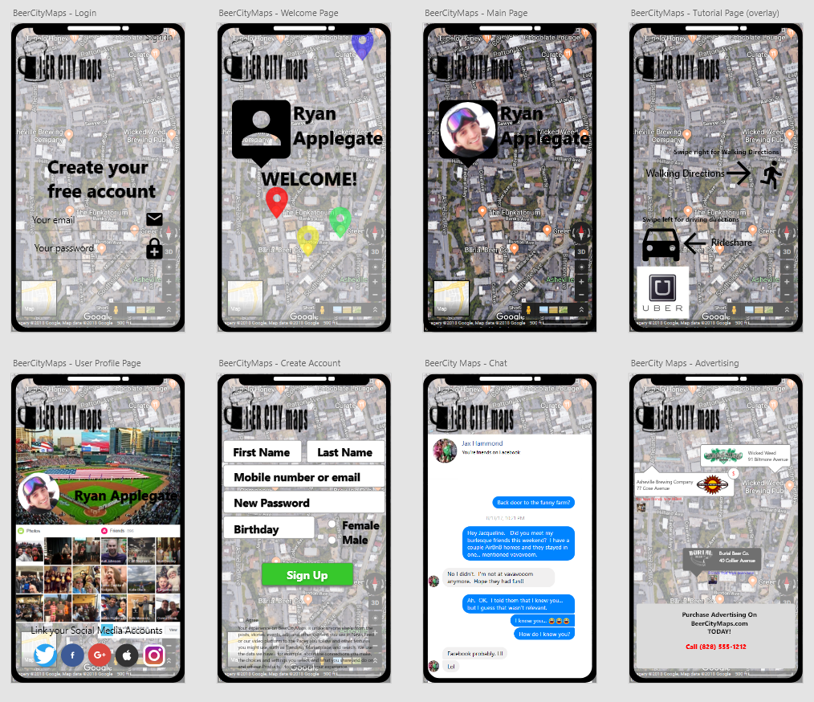
BeerCityMaps
Seeks to provide…
Directions to the closest breweries!
Enticement through advertising
Interaction
Socialization
Notes:
What BeerCityMaps aims to do is engage users and provide
Directions of course… to the nearest brewery
But also to help find the best beer in Asheville.
To also engage users by providing a seamless way to interact with others in the area by utilizing social media
And a place to review and make suggestions based on their experience

Slide 8
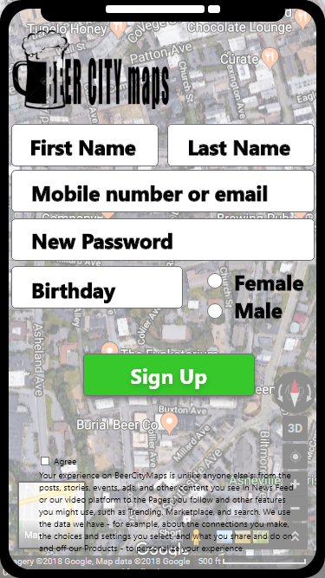
Create an account BeerCityMaps
Notes:
If a user has not been to BeerCityMaps previously, they’ll receive a login screen.
I also envision an option to login with Facebook or Google
(regardless of what everyone in here thinks, I believe it’s a popular option!)

Slide 9
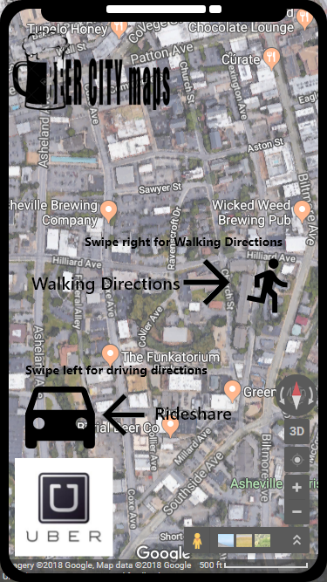
Tutorial overlays BeerCityMaps
Notes:
I’d like to have semitransparent overlays to guide users who are using the app for the first time.
After the user registers and allows location detection, then a map will display with the nearest 5 breweries indicated.
If the user is in downtown Asheville… say at the post office… then the map will be very small. Zoomed in.
If the user is at the border of Candler, then the map will have to be zoomed out to accommodate the 5 brewery rule.

Slide 10
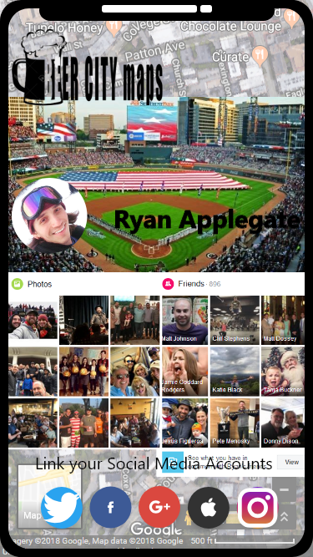
User Profile Page BeerCityMaps
Notes:
Merging of social media.
Utilizing pictures from Instagram and information from facebook

Slide 11
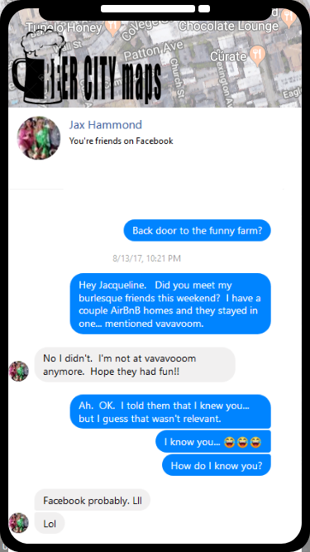
CHAT! BeerCityMaps

